Slide 1
Structured Query Language II
11.6.24

Slide 2
Chinook Practice Database
Simulated data for a digital media company
Customer and Employee Info
Invoices
Product info (artists, albums etc.)

Slide 3
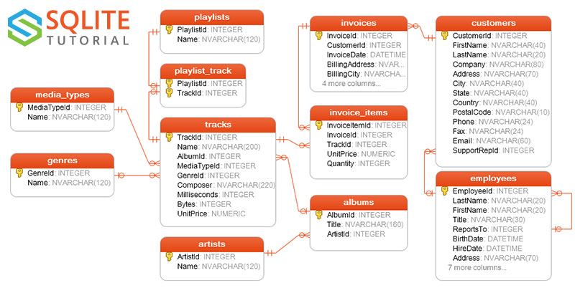
Chinook Practice Database
https://docs.yugabyte.com/preview/sample-data/chinook/

Slide 4
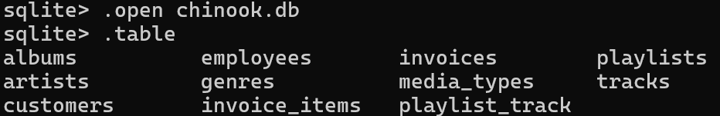
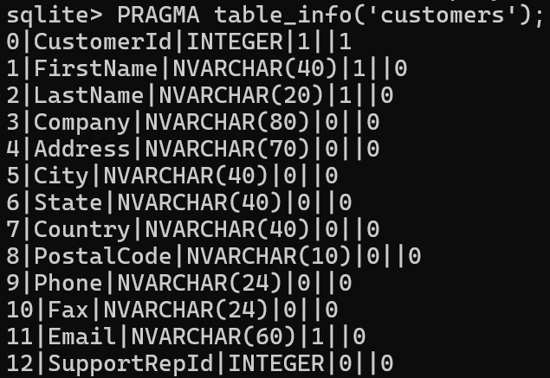
Chinook Practice Database
Column Name/type with
PRAGMA table_info(‘customers’)

Slide 5
Outputting Data
From command-line: use “>”
sqlite3 chinook.db "SELECT * FROM albums" > albums.txt
From within sqlite: change mode to .output:
.output albums2.txt
SELECT * FROM albums;
.output
Everything in this block(s) gets written
Call without an address to turn-off

Slide 6
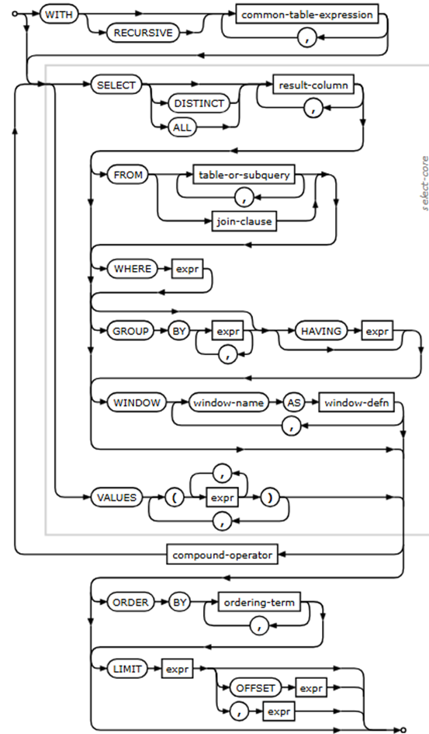
SELECT statement-flow
SELECT column_names
FROM table_name
WHERE condition
https://www.sqlite.org/lang_select.html

Slide 7
SELECT review
First 3 customers, all columns:
SELECT * FROM customers LIMIT 3
Names of Canadians with a gmail-account:
SELECT FirstName, LastName
FROM customers
WHERE Country=‘Canada’
AND Email LIKE ‘%gmail.com’;

Slide 8
SELECT review
Names of Canadians who don’t have a gmail-account:
SELECT FirstName, LastName
FROM customers
WHERE Country='Canada'
AND Email NOT LIKE '%gmail.com';

Slide 9
String Transformations for SELECT
UPPER/ LOWER
LENGTH
LIKE
TRIM-removes whitespace
CONCAT
REPLACE
SUBSTR: Extract substring based on position
INSTR: Find position of first substring match (else 0)

Slide 10
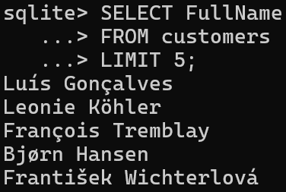
Adding a Full-Name column with CONCAT
First define a new column
ALTER TABLE customers
ADD COLUMN FullName TEXT;
Concat can take up to 254 args.
Assign values using CONCAT
UPDATE customers
SET FullName=CONCAT(
FirstName,' ',LastName);
(Testing that it worked)

Slide 11
Extracting Email Domains
Substring selection: SUBSTR(col_name, start, end)
Steps:
Find the first occurrence of ‘@’=INSTR(Email,’@’)
2. Select from that point to the end of the string = LENGTH(Email)
SELECT SUBSTR(Email, INSTR(Email, '@')+1, LENGTH(Email)) FROM customers;

Slide 12
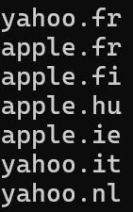

Extracting Email Domains
There are separate domain endings for different countries
What rule could we use to get just the ‘apple’, ‘yahoo’ etc. from emails?

Slide 13
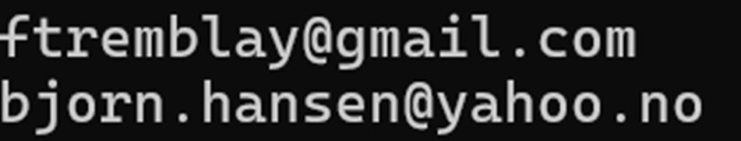
Extracting Email Domains
We need to get string between first @ and first period after @
We could nest some more SUBSTR, INSTR, but we want clean code

Slide 14
WITH clause
Declare a temporary variable before SELECT
WITH tbl_name (col_1, col2…)
AS (expression1, expression2…) …

Slide 15
Extracting Email Domains
Substring after @
SQL Queries are one LONG command.
WITH tmpTbl(endCol) AS
(SELECT SUBSTR(Email, INSTR(Email, '@')+1, LENGTH(Email))
FROM customers)
SELECT DISTINCT SUBSTR(endCol, 1, INSTR(endCol, '.')-1)
FROM tmpTbl;
Substring before first period
This asks for unique values only

Slide 16
Aggregates
Added to a SELECT statement:
AVG, COUNT, MAX, MIN, SUM, TOTAL (like sum but always float)
Usually combined with GROUP BY e.g.
SELECT AVG(col_1) GROUP BY col_2;
Opt. ORDER BY x + ascending (ASC) or descending (DESC) flags

Slide 17
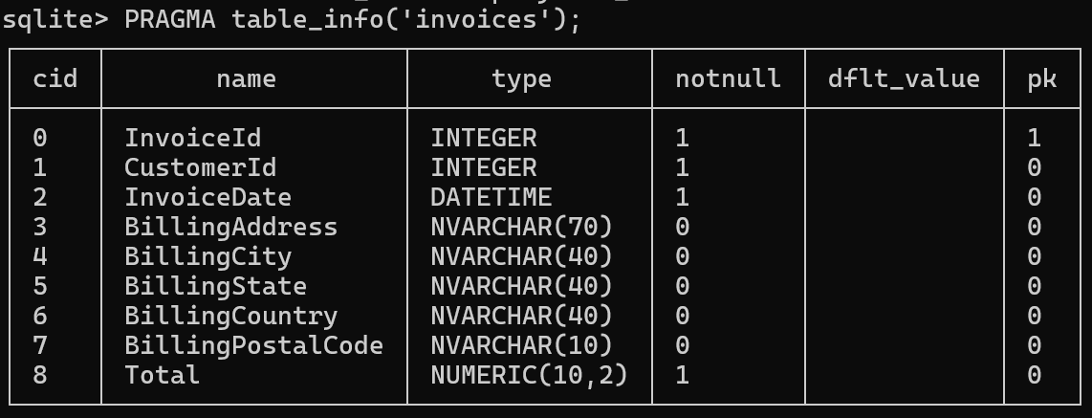
Aggregates
Let’s get the total number of sales per Country (billing)
Which Aggregate Should I use?

Slide 18
Counting by Country
I want to return the COUNT per country and the names of each country
SELECT BillingCountry, COUNT(*)
FROM invoices
GROUP BY BillingCountry
ORDER BY COUNT(*) DESC;

Slide 19
Practice—Unique addresses per country
Return the number of users (identified by unique addresses) per country
Addresses are in the column BillingAddress

Slide 20
CASE Statements
SQLite lacks loops, but we can do cases
CASE
WHEN <clause> THEN <result>
WHEN <clause> THEN <result>
ELSE <clause>
END

Slide 21
Let’s divide addresses into domestic / foreign in a new table
CREATE TEMPORARY TABLE isDomestic AS
SELECT BillingCountry,
CASE
WHEN BillingCountry='USA' THEN 'domestic'
ELSE 'foreign' END
AS country
FROM invoices;
2 columns: a copy of BillingCountry + the case-wise statement
Save this column as country

Slide 22
Relating Tables
Next, we want to get the most popular albums in each genre
This information is spread across four tables:
invoice_items-sales including a track-ID
genres: lookup-table for genre-ID
tracks: song-info, including song-title, GenreId
albums: lookup-table for Album-ID

Slide 23
Relating Tables
genres
invoice_items
tracks
GenreId
Name
TrackId
TrackId
Name
albums
GenreId
AlbumId
AlbumId
Title

Slide 24
Types of Key
Primary Key: uniquely identifies a record (row) of its table
Usually a single col. but sometimes use a “composite key” made of 2+ columns
Foreign Key: contains another table’s primary
Doesn’t have to be unique
To enable Foreign Key declarations: PRAGMA foreign_keys = ON;
We’ll use the concept today, without actually declaring it

Slide 25
Types of Key
Foreign keys are most useful for mappings that are not 1:1
Foreign Key:
Song
Primary Key:
Transaction
Primary Key:
Song
Song A
1001
Song A
Song A
1002
Song B
Song B
1003
Song B
1004
Song B
1005

Slide 26
Relating Tables
genres
invoice_items
tracks
GenreId
TrackId
Name
TrackId
Name
albums
GenreId
AlbumId
PRIMARY KEY
FOREIGN KEY
AlbumId
Title

Slide 27
Relating Tables
GROUP BY genres
genres
invoice_items
tracks
GenreId
TrackId
Name
TrackId
Name
albums
GenreId
AlbumId
COUNT
invoice/track
AlbumId
Title
SUM within album

Slide 28
JOINS
The simplest solution here is to just JOIN all of the data together based upon matching Keys instead of adding a bunch of WITH’s.
Join invoice_items and tracks based upon TrackId
Then Join the result with genres, albums based upon GenreId, AlbumId

Slide 29
JOIN types
Defined by behavior when not all rows have a match
(all equivalent when there’s full matching)
Nonmatches filled with NULL
INNER JOIN: Only rows with a key in both tables
OUTER JOIN: All rows
LEFT(/RIGHT) JOIN: All rows from the left(/right) table
Joins can use matching condition (=) or inequalities (< or >)
Inequality Joins copy every row matching the condition

Slide 30
Referencing Multiple Tables
Join and related commands involve multiple tables, which could have overlapping column names
FROM table1 JOIN table2 ON table1.id=table2.id;
or
FROM table1 t1 JOIN table2 t2 ON t1.id=t2.id;
t1 is serving as an alias-name for table1

Slide 31
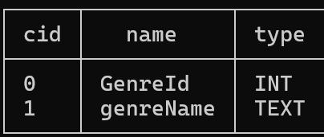
Preparing to Join
One thing to note: genre and tracks both have a “Name” column
I’ll copy into a temporary table and rename:
CREATE TEMPORARY TABLE tmpGenre
AS SELECT * FROM genres;
ALTER TABLE tmpGenre
RENAME COLUMN Name TO genreName;

Slide 32
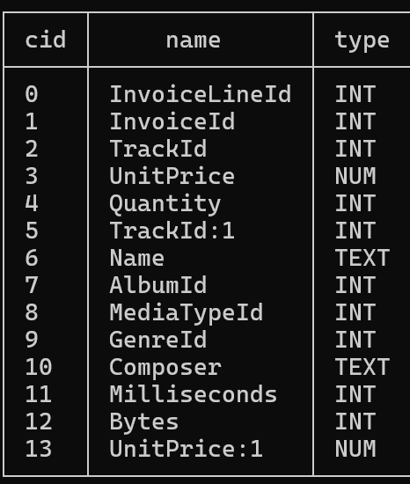
Join Order
It’s possible some tracks don’t have any sales—we should ignore those: items (left-join) tracks
As a temporary table:
CREATE TEMPORARY TABLE SoldTracks
AS SELECT * FROM invoice_items
LEFT JOIN tracks ON invoice_items.trackID=tracks.trackID;
Column names that appear in both

Slide 33
Combining (this is a single query)
CREATE TEMPORARY TABLE tmpTab AS
WITH tmpGenre AS
(SELECT s.genreId, s.albumId, g.genreName
FROM SoldTracks s
JOIN tmpGenre g ON s.genreId=g.genreId)
SELECT t.genreId, t.albumId, t.genreName, a.Title
FROM tmpTitle t
JOIN albums a ON
t.albumId=a.albumId;
Create a local table tmpGenre containing matched genre names by JOIN on genreId
Join tmpGenre wth corresponding album Titles based on albumId

Slide 34
Finally, getting the top albums/genre
WITH totSales(ct,Title,genreName) AS
(SELECT COUNT(*), Title, genreName
FROM tmpTab GROUP BY Title)
SELECT MAX(ct), Title, genreName
FROM totSales GROUP BY genreName;
Count rows (invoices) for each title and store as local table totSales
Report album title with maximal sales per genre

Slide 35
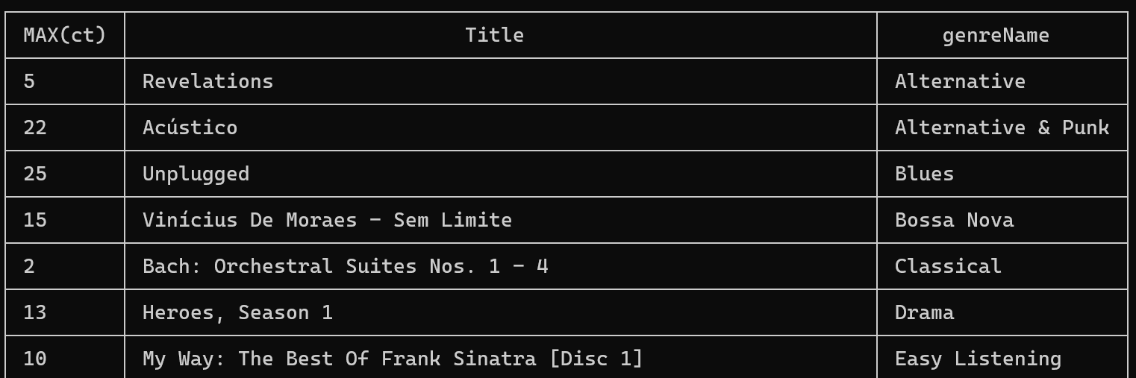
Finally, getting the top albums/genre

Slide 36
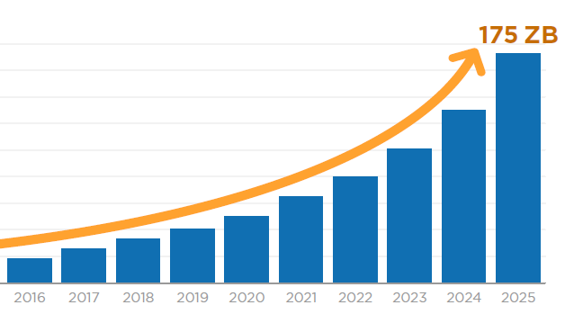
Some Closing Notes on SQL
You will spend much of your SQL time reorganizing things and doing simple math
It’s designed for highly optimized search and matching
It’s a conversation—you send the server questions, it figures out how to answer
However, you can optimize the order of operations (minimal redundancy) we were very non-optimal
Data Growth

Slide 37

Some Closing Notes on SQL
SQL has minimal syntax. This makes it easy to interpret data as code
https://en.wikipedia.org/wiki/SQL_injection
https://www.xkcd.com/327/

